Slide 1
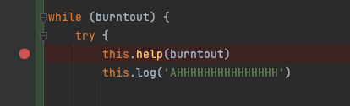
Debugging Burnout
A Distilled Conversation

Slide 2
Big Note
I am not a therapist

Slide 3
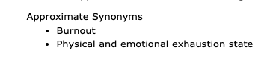
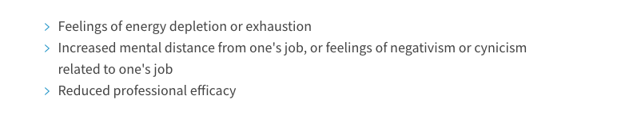
What is burnout?
ICD-11: workplace burnout
Notes:
International Center For Diseases revision 10
Maslach Burnout Inventory

Slide 4
What is burnout?
Expectations
E
n
e
r
g
y
The imbalance of Expectations, Environment, and Energy
Environment

Slide 5
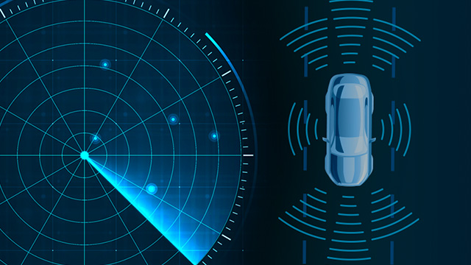
Environment
As perceived by you

Slide 6
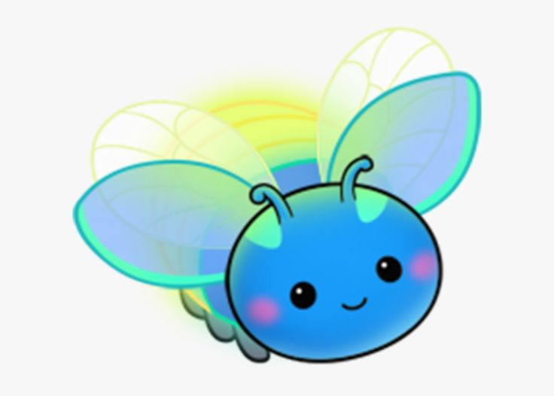
BUG:
I’m just… AHHH!

Slide 7
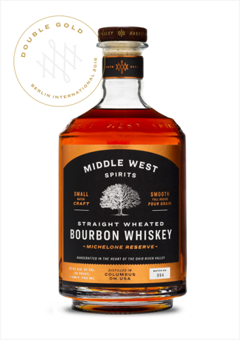
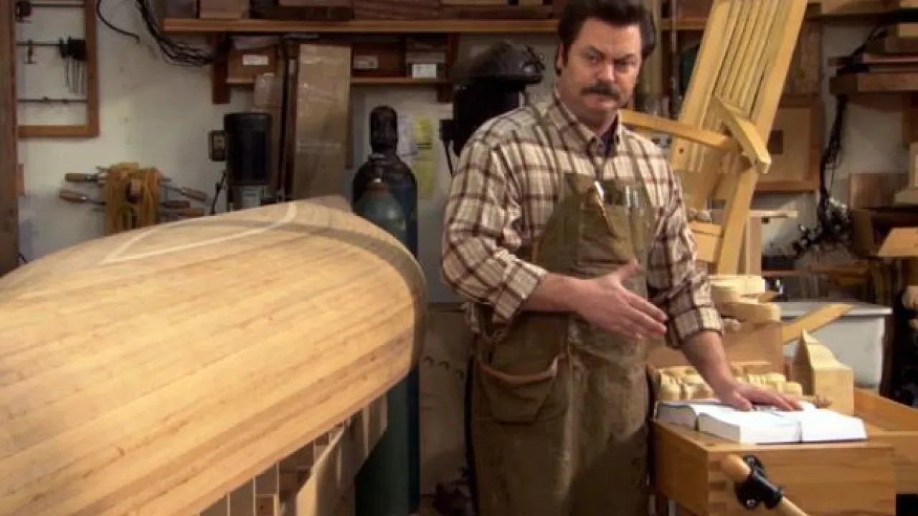
Words Matter
Grain…
Porous…
Aged…
On the nose…
Initial taste…
Finish…
Notes:
On the nose​
Aromas of banana, coconut cream pie, and toffeed nuts​
Initial taste​
Supple, fruity, medium-to-full body​
Finish​
Sweet cream, dried fruit, honeyed whole nut, and baking spices finish​

Slide 8
How are you doing?
Good.
Notes:
Dialogical

Slide 9

Mood Meter
Enraged
Surprised
Livid
Tense
Frightened
Optimistic
High
Energy
Pessimistic
Calm
Low
Lonely
Chill
Cozy
Unpleasant
Pleasant
Feelings

Slide 10
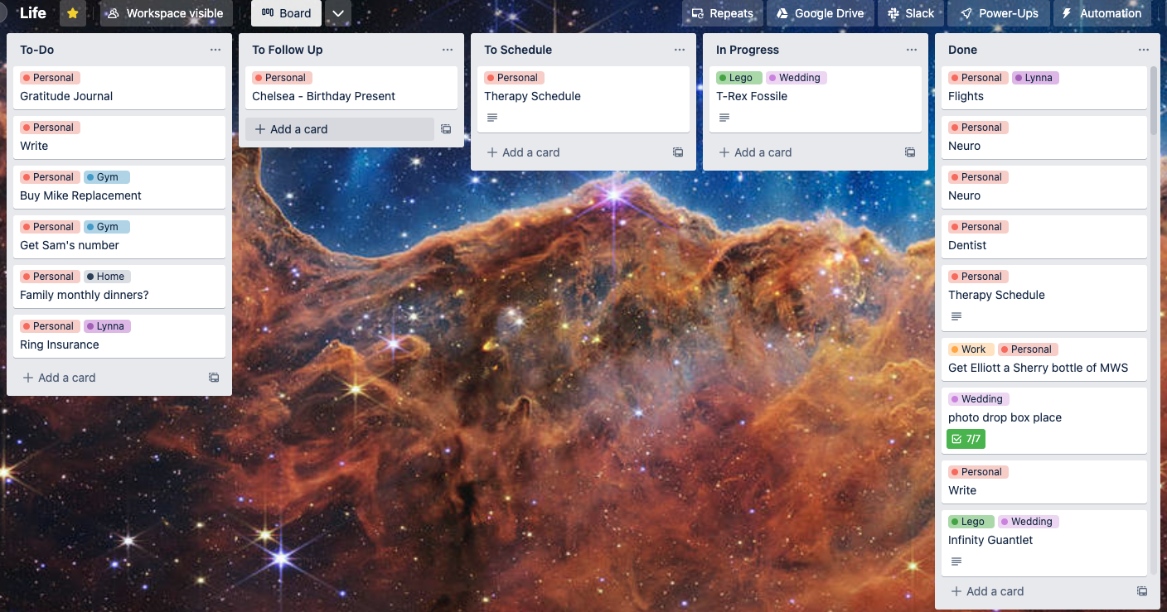
TOOL:
Carding
Label it! What are you feeling? What do you want to be feeling?

Slide 11
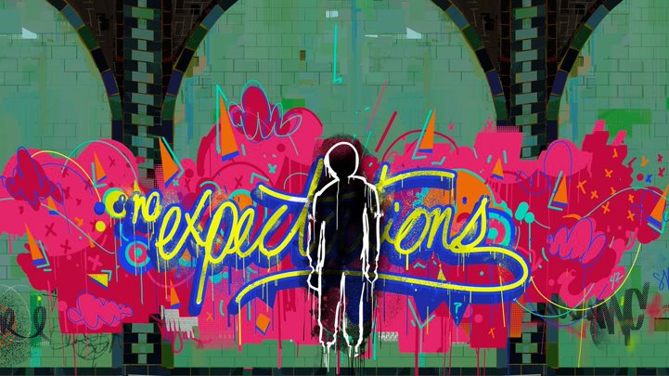
Expectations
An exercise in resonance

Slide 12
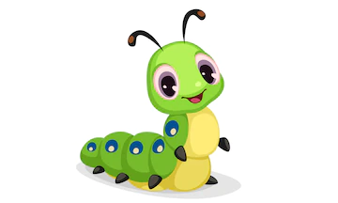
BUG:
When I try to make changes,
life keeps getting in the way

Slide 13
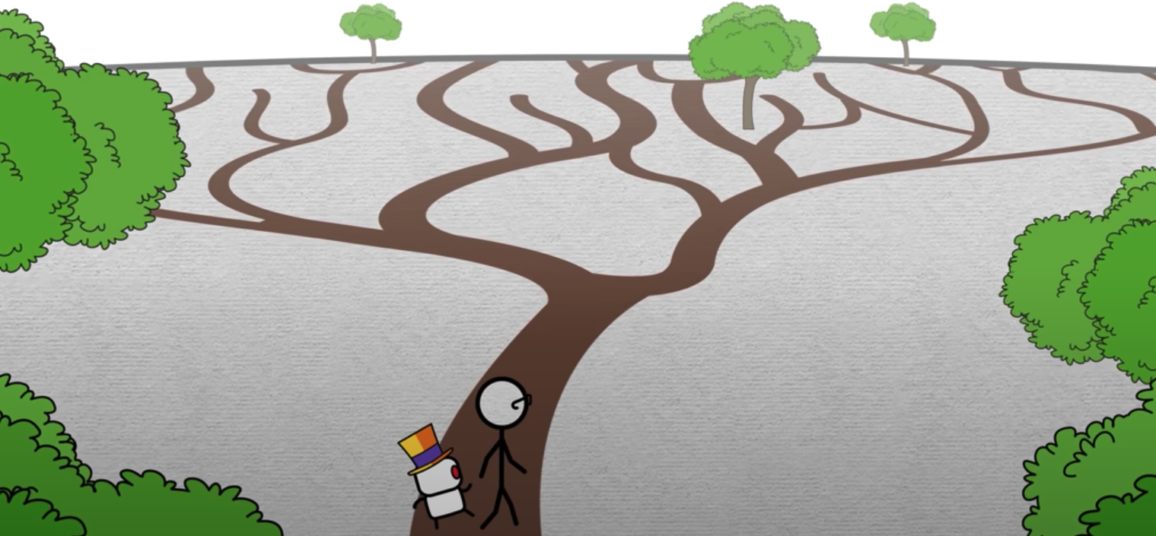
Themes
Debugging Burnout
Good for grace
Good for life change
Good for growth

Slide 14
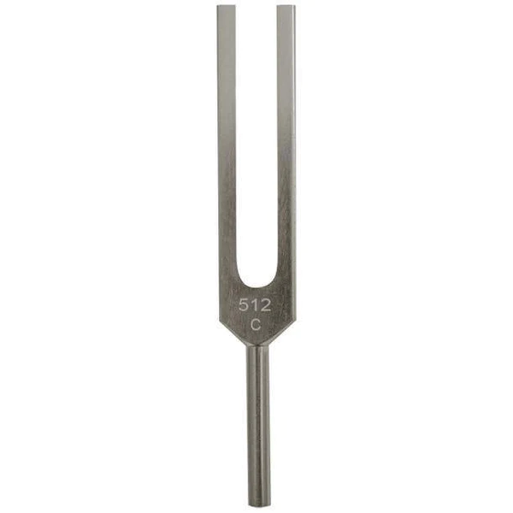

Theming
Intentionally Vague
Trendline
Winter of Balance
Resonance (Oxford Dictionary)
the reinforcement or prolongation of sound by reflection from a surface or by the synchronous vibration of a neighboring object.

Slide 15
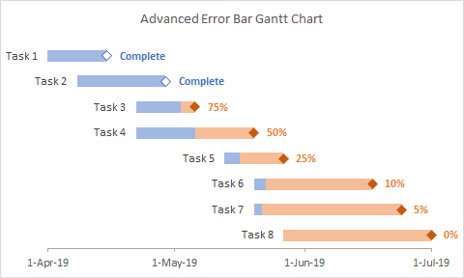
TOOL:
Estimations
Give flexibility in your guesses

Slide 16
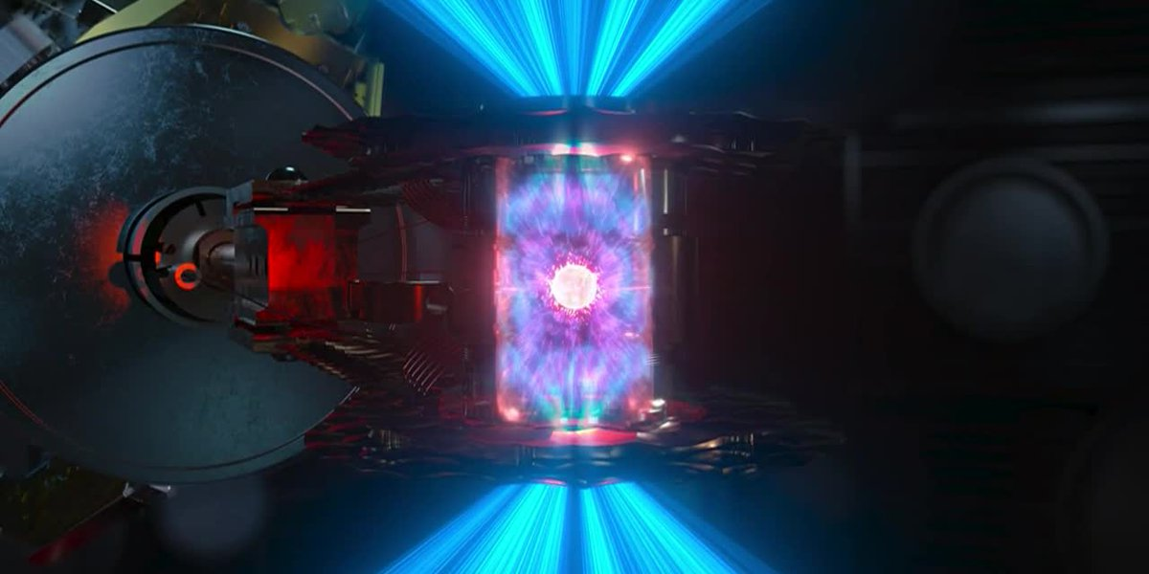
Energy
Collect and protect

Slide 17
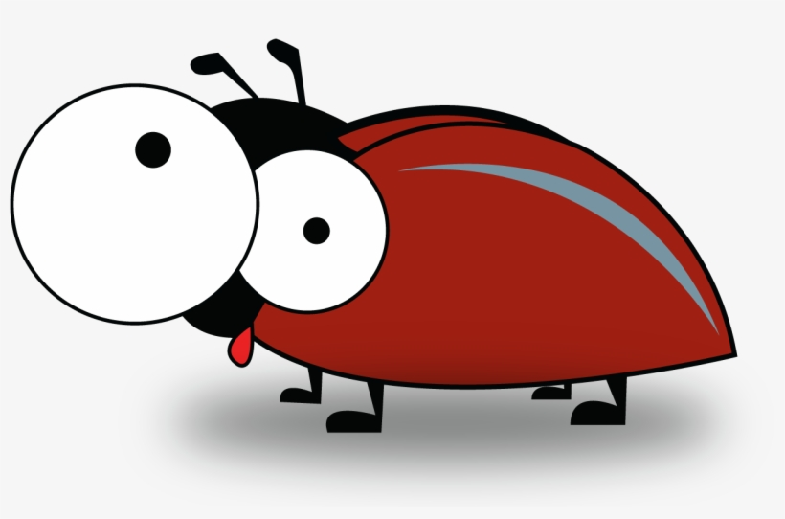
BUG:
The world sucks, why bother

Slide 18
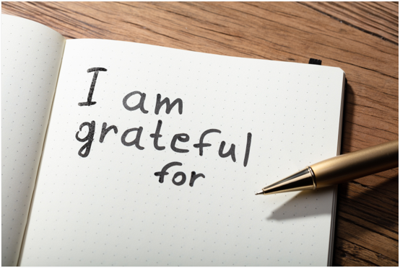
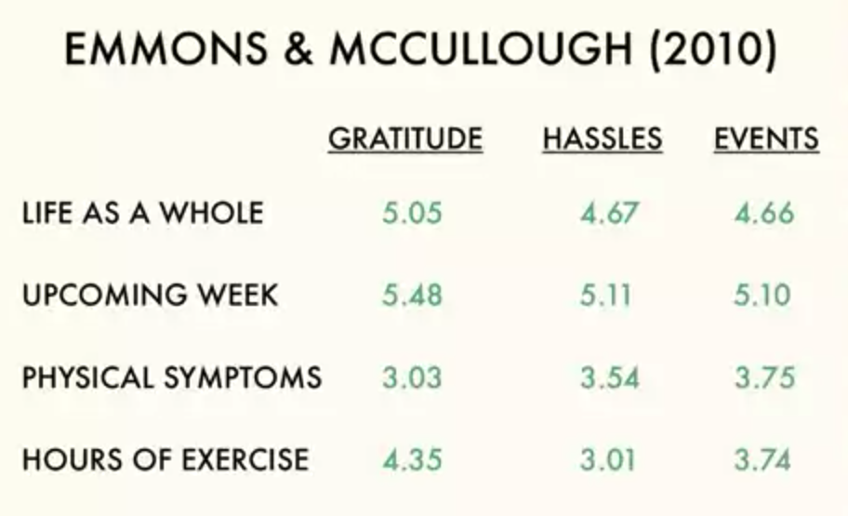
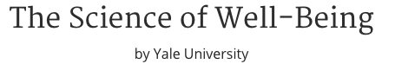
Gratitude
Think of 5 things you’re grateful for. Write them down.
Notes:
Emmons & McCullough
Score 1-7: ____1. I have so much in life for which to be thankful.
____2. If I had to list everything that I felt grateful for, it would be a very long list.
____3. When I look at the world, I don't see much for which to be grateful.*
____4. I am grateful to a wide variety of people.
____5. As I get older I find myself more able to appreciate the people, events, and situations that have been part of my life history.
____6. Long amounts of time can go by before I feel grateful to something or someone.*

Slide 19
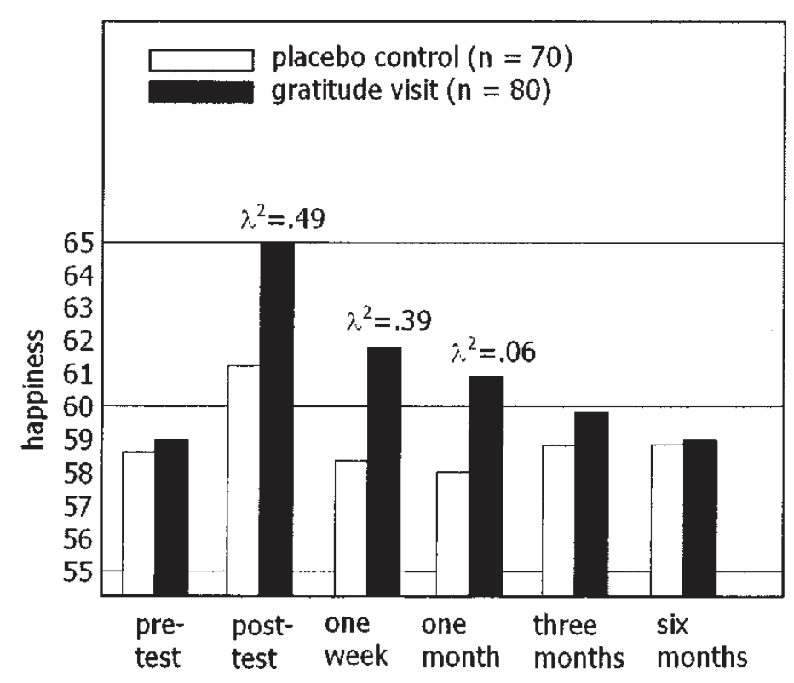
Gratitude
Write & deliver a note of gratitude to someone
Notes:
Positive Psychology Progress Seligman

Slide 20

TOOL:
Pairing
Have someone(s) to challenge and refine your perspective

Slide 21
Common Definition
Debugging Burnout
The imbalance of Expectations, Environment, and Energy

Slide 22
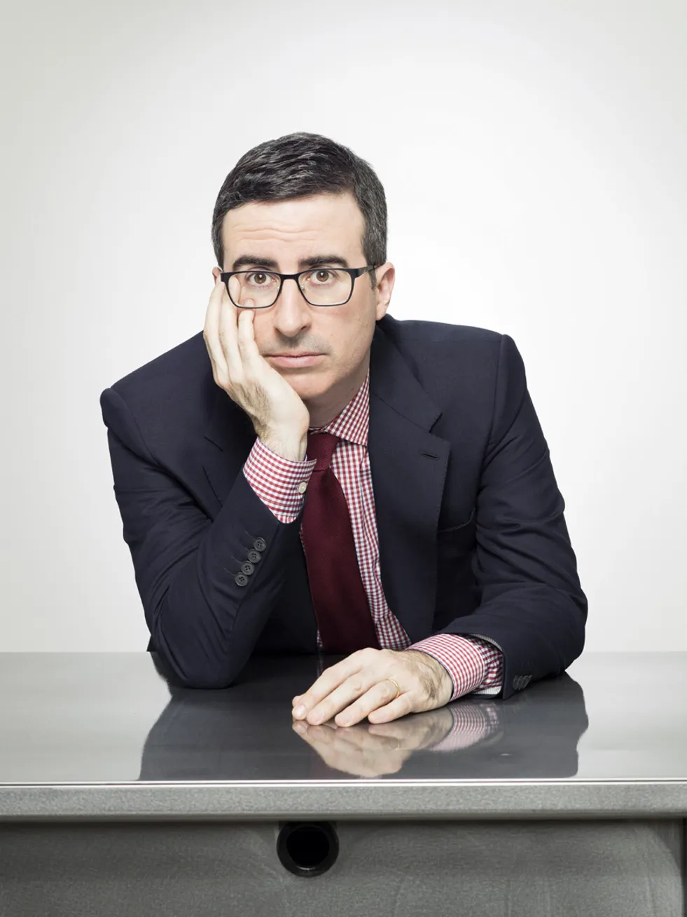
“What Can We Do?”
John Oliver

Slide 23
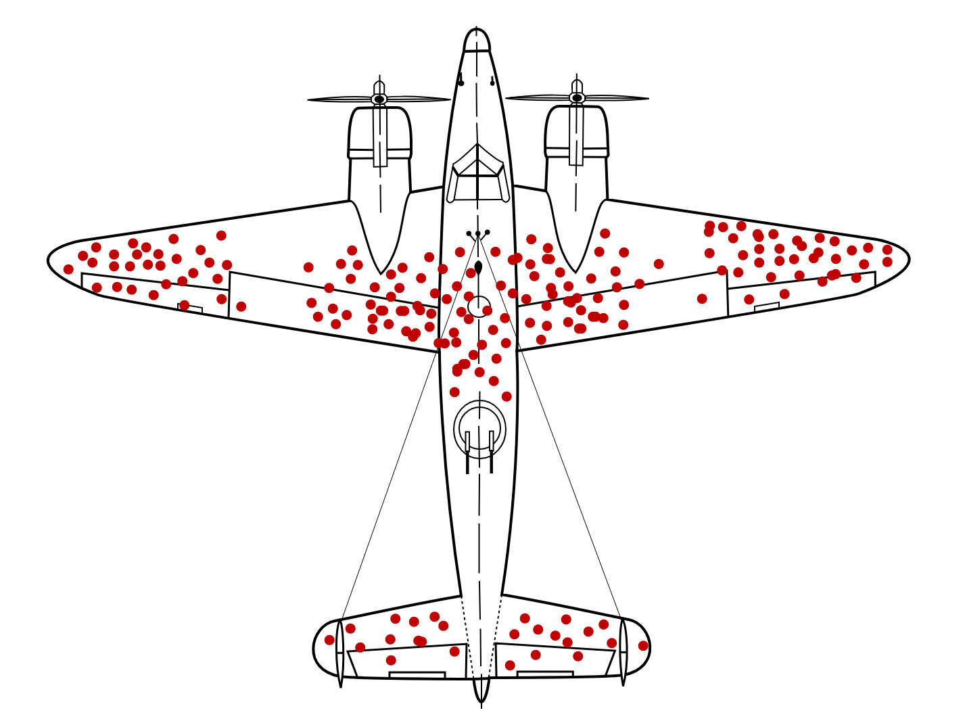
What to watch out for
Debugging Burnout
Sunk Cost Fallacy

Slide 24
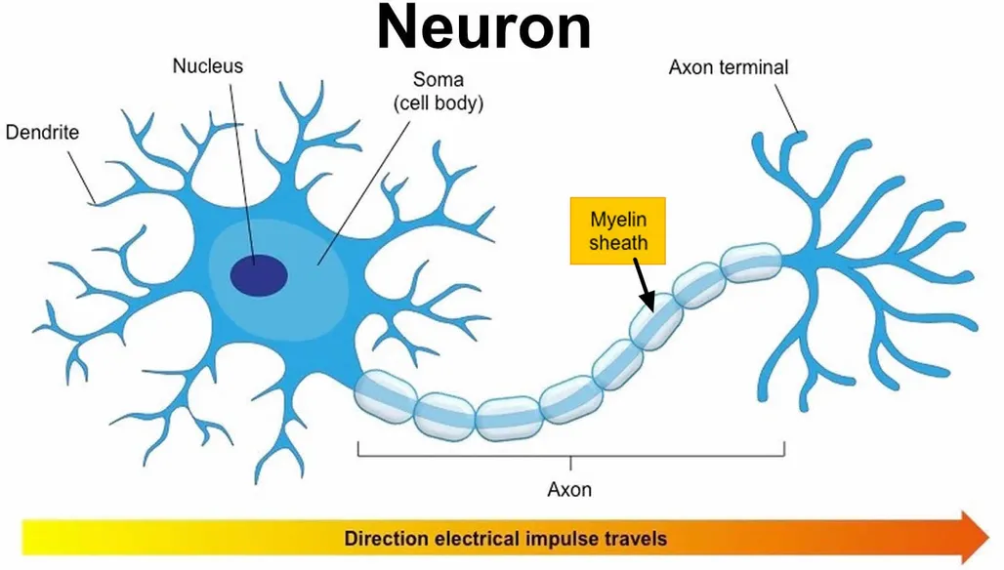
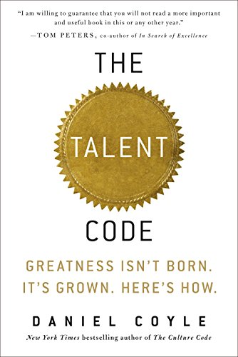
What to build
Debugging Burnout
Myelin

Slide 25
Start Debugging!

Slide 26
Expectations
Themes
Estimations
E
n
e
r
g
y
Gratitude
Pairing
Language
Environment
Carding

Slide 27
This is the most important takeaway that everyone has to remember:

Slide 28
Burnout’s hard
Expectations
E
n
e
r
g
y
Keep the conversation going
Environment
Notes:
Finding balance can help!
Conversations are important!
You can solve hard problems!

Slide 29
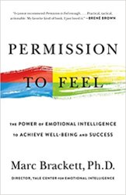
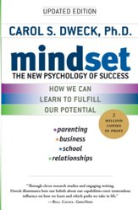

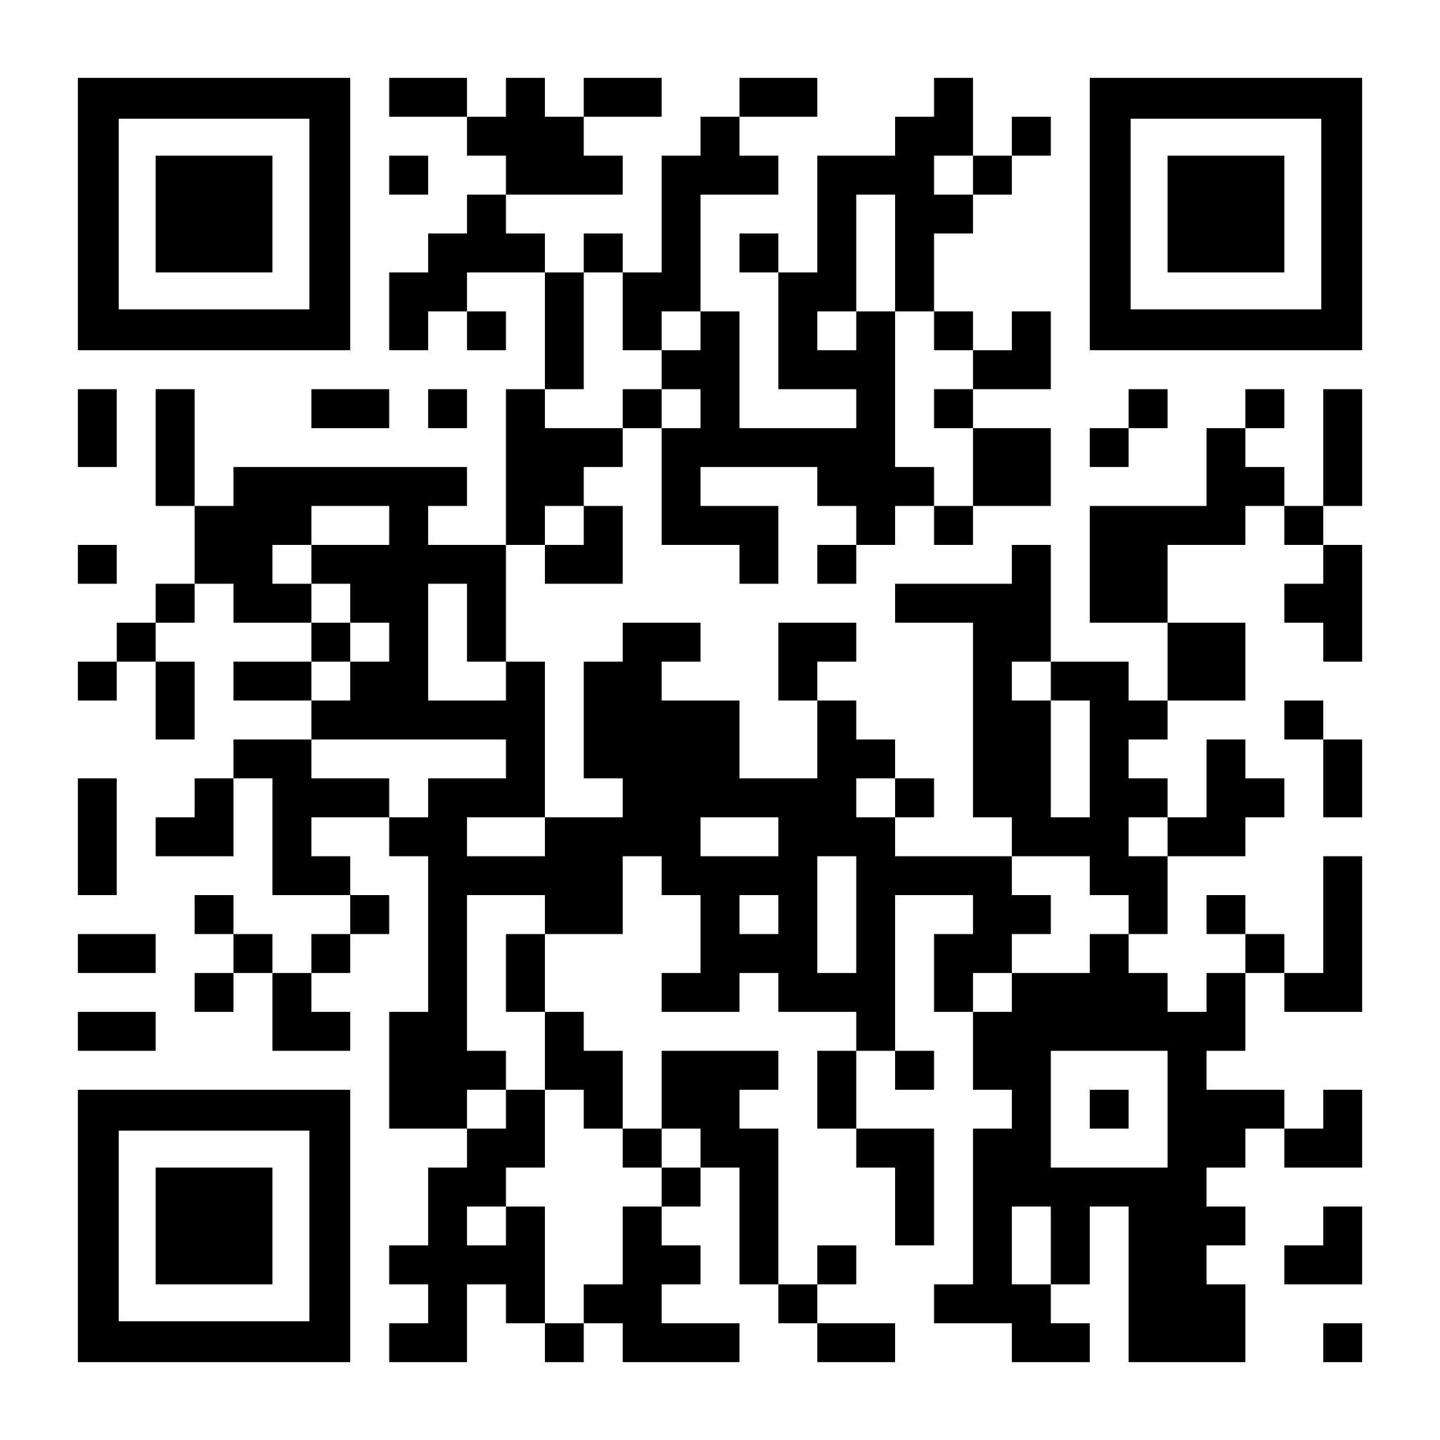
Sources
2 hours of nature:
https://www.nature.com/articles/s41598-019-44097-3
Yale: The Science of Well Being
https://www.coursera.org/learn/the-science-of-well-being
Your Theme (CGP Grey)
https://www.youtube.com/watch?v=NVGuFdX5guE
Gratitude (Kurzgesagt)​
https://www.youtube.com/watch?v=WPPPFqsECz0
Core Value Cards (W.R. Miller, J. C’de Baca, D.B. Matthews, P.L. Wilbourne UNM, 2001)​
https://motivationalinterviewing.org/sites/default/files/valuescardsort_0.pdf

